Slide 1
Periodic Law
Chapter 7

Slide 2
Topics
7.1 Development of the table
7.2 Effective Nuclear Charge
7.3 Size of atoms/ions
7.4 Ionization Energy
7.5 Metals, Nonmetals, and Metalloids
7.6 Group Trends

Slide 3
Problem Set
Chapter 7 - Worth 4% on the test
7.4, 7, 9, 10, 13, 15, 16, 20, 23, 24, 27, 30, 33, 35, 37, 38, 43, 48, 49,

Slide 4
Purpose of this chapter
To examine the properties of elements and how they change as we move across a row and down a column
This creates trends or “periodicity”
Helps a chemist have a better understanding of the relationship between elements, their atomic number, and their chemical properties

Slide 5
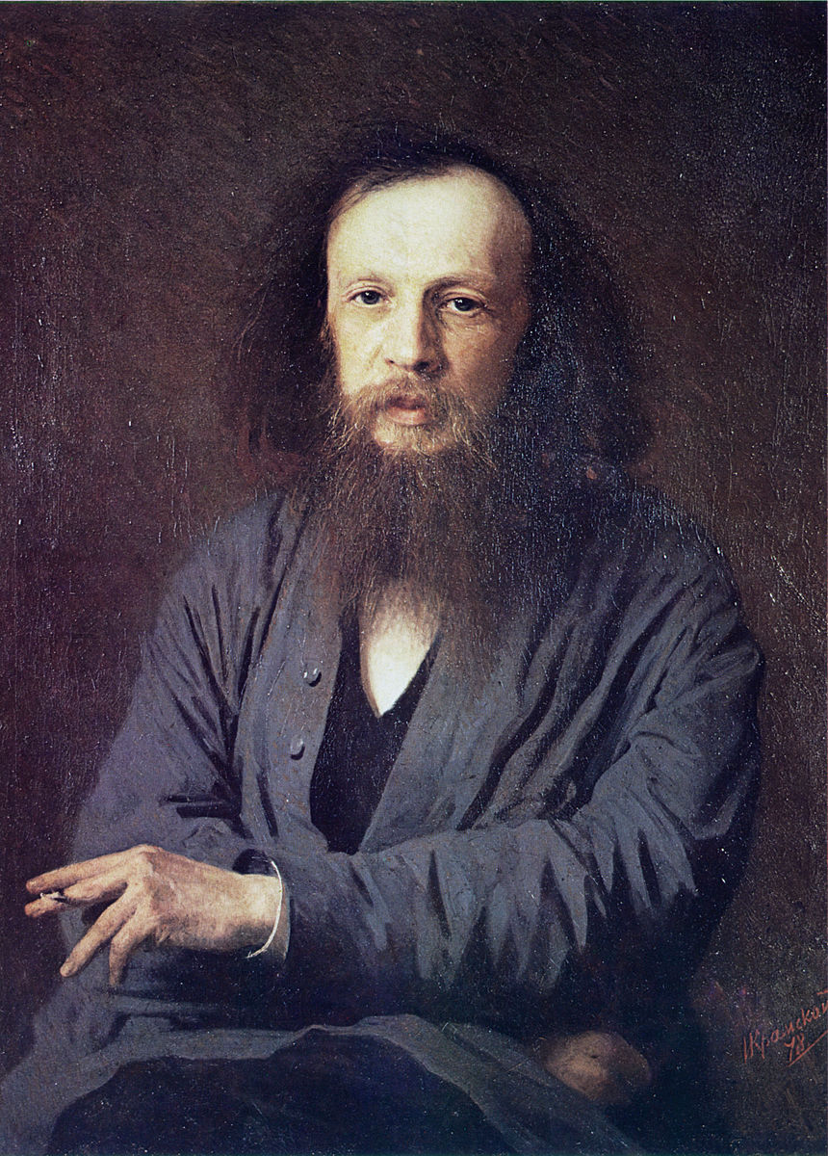
7.1 Development of the Table
Periodic Table begins to take shape around 1869 by the work of Dmitri Mendeleev (not that long ago)
This type of science was revolutionary in what humans understood about the matter that makes up this planet
Gold was discovered many years prior and around Mendeleev’s time 63 elements had already been discovered,
But they weren’t organized in any particular way and not much was understood regarding trending

Slide 6
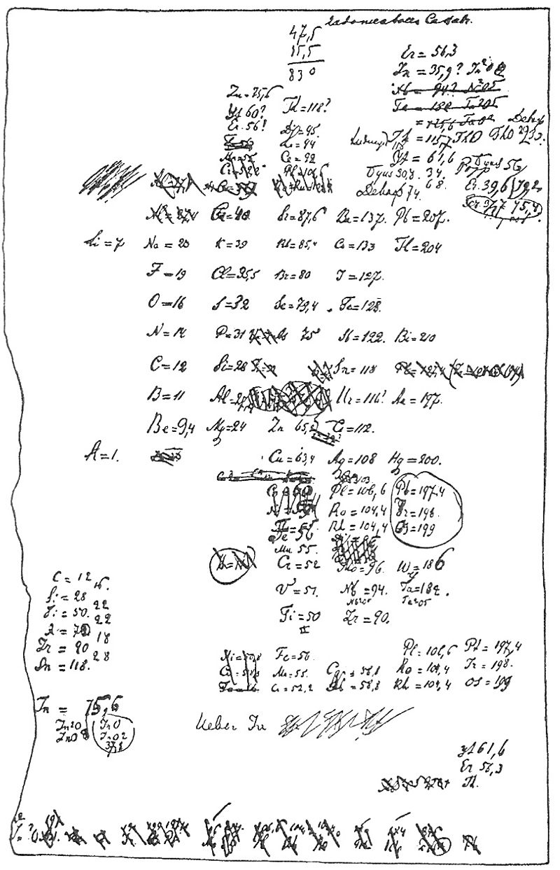
Early Periodic Table
Mendeleev and his colleague Meyer observed periodic trends in the way elements behaved
Especially when they were arranged in increasing atomic weights
Mendeleev knew little of atomic numbers at the time or really subatomic particles
Spaces in the table left by Mendeleev because he was insistent in grouping the table in “families”

Slide 7
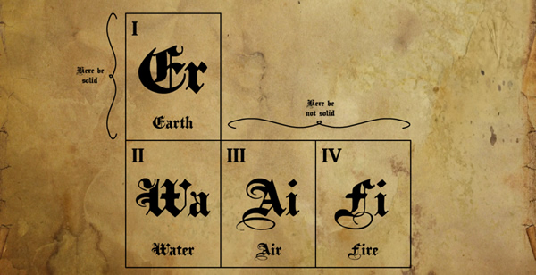
Ancient “science”
In the times of Aristotle and Democritus, matter was thought to be rooted in these 4 “elements”

Slide 8
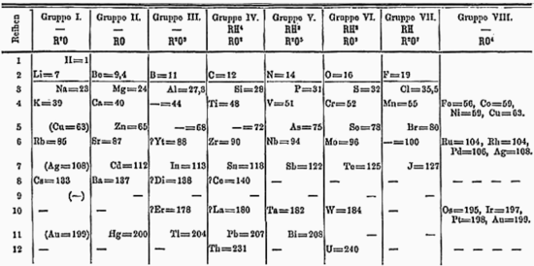
Early Table by Mendeleev

Slide 9
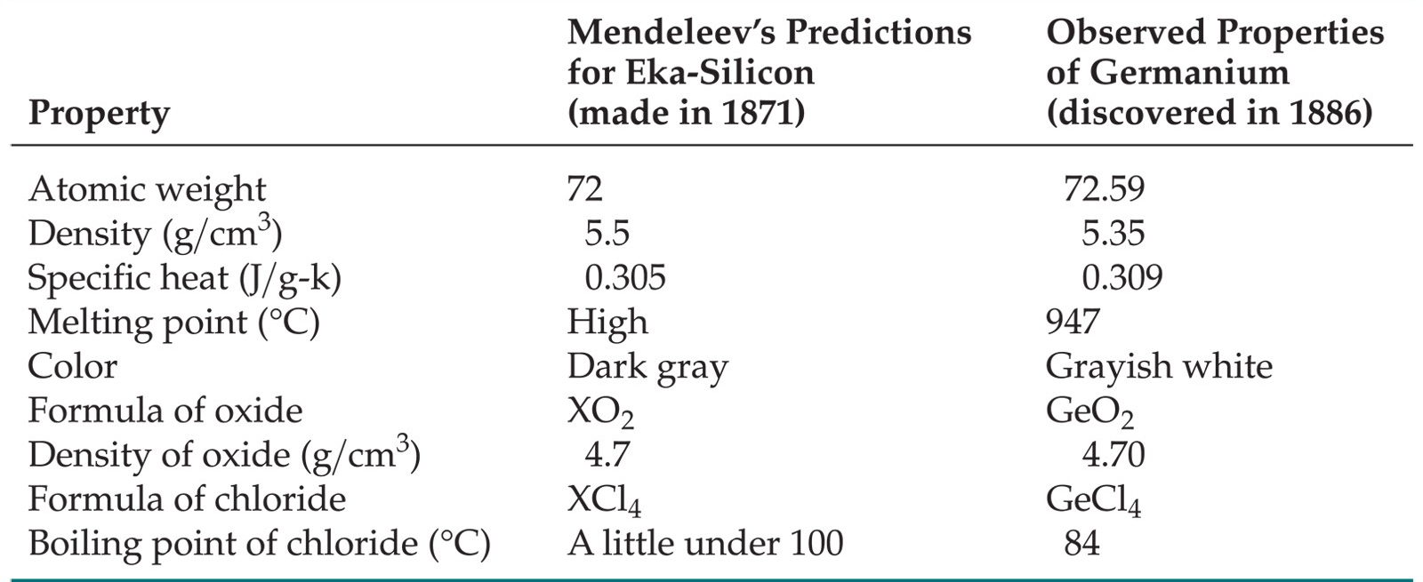
Development of the Table
Comparison between modern values and Mendeleev’s values

Slide 10
More relatable (illustrated) table

Slide 11
More modern and descriptive table

Slide 12
7.2 Effective Nuclear Charge
Electrons are held with together in the nucleus due to the attractive forces of positively charged nucleus
But they are also repulsed by each other (two neg. charged electrons)
Describing the interactions of multi electron atoms is difficult and not really even possible at this time

Slide 13
7.2 Effective Nuclear Charge
But the effective nuclear charge on the atom (Zeff) helps us describe a net electric charge of the atom overall
Zeff = Z - S where… (this is a simplified version)
Z = number of protons in the nucleus
S = screening constant (core electrons)
Core electron – electrons that are not valence (outer s and p orbitals)

Slide 14
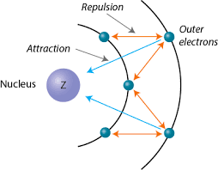
7.2 Effective Nuclear Charge
Electrons in outer orbitals are “shielded” by charge of the nucleus due to the repulsion of inner electrons
S is usually the number of core electrons (d or f orbitals, s and p non valence)
We‘ll examine the trend and relationship between this concept later
Affects almost every other periodic trend we will discuss

Slide 15
Calculating Zeff
Calculate the Zeff for for sodium
Calculate the Zeff for for carbon

Slide 16
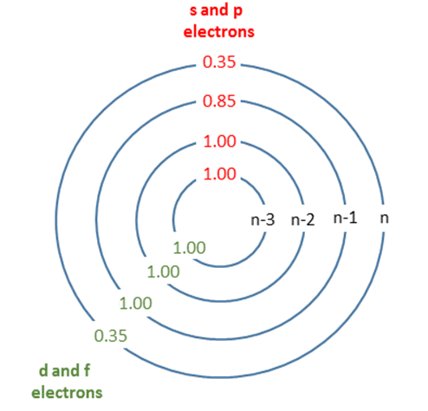
Slater’s Rule
More sophisticated way to calculate Zeff
Can be done for every electron in an atom
Used to fit experimental data and explain quantum concepts especially those of electron figurations and bonding principles

Slide 17
Slater’s Rule

Slide 18
Applications of Slater’s Rule
Describes why there is an order to the way we right electron configurations
Explains why 4s electron’s are lost before 3p electron’s
The effective nuclear charge on them is lower!
Again, allows us to calculate Zeff on any electron
Will Zeff be higher or lower for valence electrons?

Slide 19
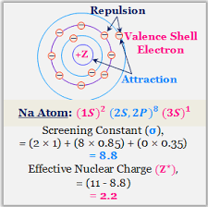
Example

Slide 20
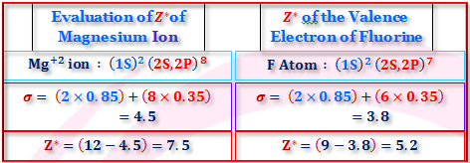
Slater’s Rule

Slide 21
Slater’s Rule to Calculate Zeff
Calculate the Zeff for a valence electron in calcium using Slater’s rule
Calculate the Zeff for a valence electron in magnesium using Slater’s rule
Calculate the Zeff for a in carbon atom Slater’s rule

Slide 22
Coulombs law and Periodicity
Periodic trends are based on two concepts
Effective nuclear charge and coulombs law
Both affect how the electrons behave as well as an elements properties overall
We must consider both Zeff and Coulombs law in our discussion of periodic trends

Slide 23
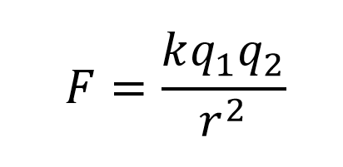
Coulombs law
The force of attraction or repulsion between 2 charged particles is dependent on the distance between them
Electrons in high energy orbitals (increasing principal quantum number) are further away from the nucleus
How is r affected
How is the attractive force on an electron affected by change in radius?
Coulombs Law Interactive
https://phet.colorado.edu/sims/html/coulombs-law/latest/coulombs-law_en.html

Slide 24
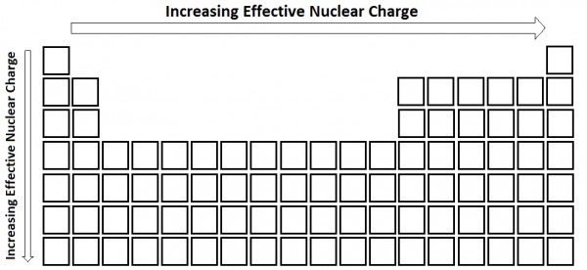
7.2 Effective Nuclear Charge Trend
A lot!
Only slightly
https://en.wikipedia.org/wiki/Effective_nuclear_charge

Slide 25
Why this trend?
Increasing going down! - Electrons closer to the nucleus experience greater attraction from the positively charged nucleus
But not much at all
More importantly in the trends we will discuss, the increase in principal quantum number (n) moves
According to Coulombs law, the further away two charged particles are, the less the force is between them
Increasing across, more protons but shielding is not a factor because electrons are in the same shell
This increase in Zeff is significant!

Slide 26
Rank the Following in Terms of Zeff (Highest to Lowest)
Gold, Copper, Silver
Hydrogen, Helium, Lithium
Fluorine, Chlorine, Sodium, Hydrogen, Potassium

Slide 27
7.3 Sizes of Atoms and Ions
An important type of trending is be atomic size
Although we treat atoms as hard spherical objects in this chapter…
Let’s keep in mind that quantum mechanics tells us that ehhhh…it’s not quite that simple
Regardless, there is solid experimental evidence that proves sizes of atoms rather reliable

Slide 28
Experimentation behind Atomic Radii
Atomic radii are measured in angstroms
1 Angstrom (Å) = 1 x 10^-10 meter
Various experimentation and estimation are used to determine the radii of elements
Depending on the type of bond, determines how the atomic radii is measured
Elements are not perfect spheres but this assumption is made to make sense of various applications like…
Density, diffusion through sieves, crystalline structure etc.

Slide 29
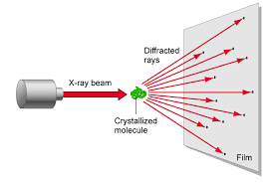
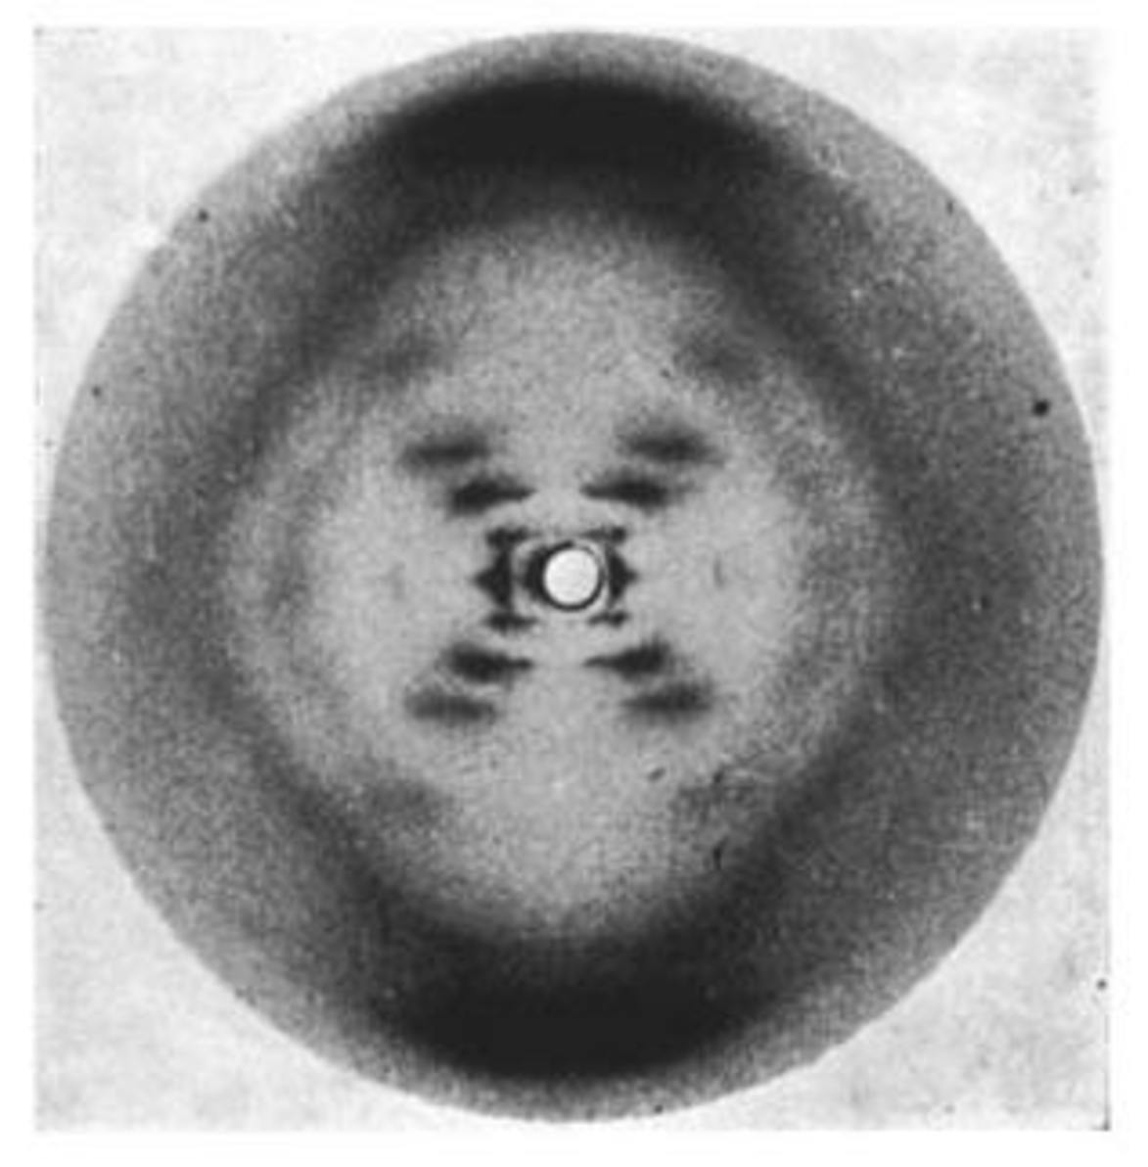
Atomic Radii (Covalent)
Atomic radii is typically calculated by using the bond length of a homonuclear element
Cl2, H2
Only useful for atoms that do bond to themselves
Performed using X-Ray Crystallography
https://www.youtube.com/watch?v=Sc1boyDsPSs

Slide 30
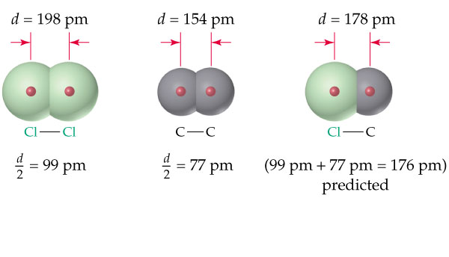
Atomic Radii (van der Waals radius)
Atomic radii determined in non bounded elements
For example, carbon in diamond (covalent network)
Elements such as Helium and Neon must have there radii estimated
No known compounds exist using these elements
Knowing atomic radii allows us to make estimations about bond length

Slide 31
7.3 Size of Atomic Radii
Periodic trends in radii
Within a column, atomic radius tends to increase from top to bottom (increasing going down)
Principal quantum number goes up —> “size” of atom increases
Shrodinger’s equation predicts these orbitals to be larger which is verified based on experimentation
Within a row, atomic radius tends to decrease left to right
Increase in Zeff corresponds to a greater pull on valence electrons towards the nucleus hence the smaller size

Slide 32
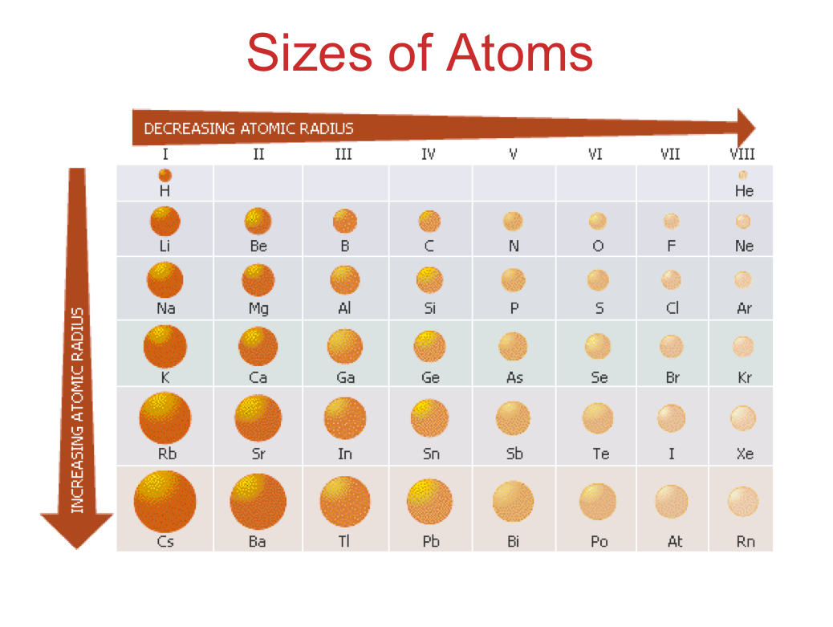
Periodic Trend in Size (Atomic Radii)

Slide 33
Trending Graph

Slide 34
Rank the following from smallest to largest in terms of atomic radii.
N, O, F
K, Ca, Mg
Cl, F, Br, I

Slide 35
7.3 Ionic Radii
Size in ionic radii also depends on change in principal quantum number (coulombs) and Zeff
Formation of a cation vacates the electrons from the outermost shell
Decrease in size in the formation of cations
Formation of anions is the opposite
Addition of electrons adds to repulsion and increases their size
Increase in size in the formation of anions

Slide 36
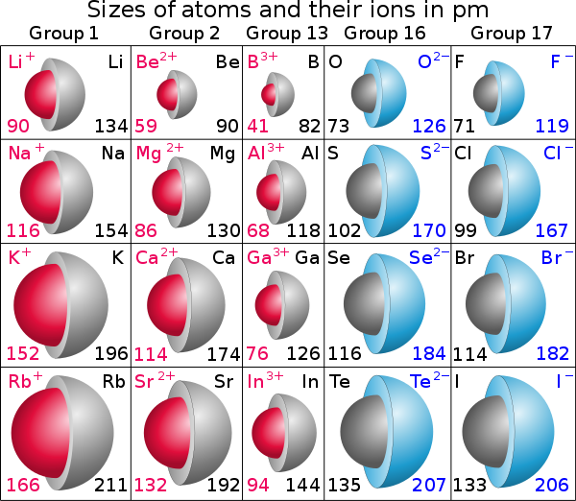

Slide 37
Arrange the following in terms of ionic size
N3-, O2-, F-
K+, Ca2+, Mg2+

Slide 38
7.4 Isoelectronic Series
Isoelectronic series - a group of ions all containing the same number of electrons
i.e. O2-, F-, Na+, Mg2+, Al3+ (10 electrons each)
For isoelectronic series, sizes of atoms are ordered based on charge, with the positive ions being the smallest
Remember, cations are smaller than there neutral atoms

Slide 39
7.4 Isoelectronic series
Rank the following, smallest to largest in terms of ionic radii for isoelectronic series
Na+, F-, Mg2+, Al3+, O2-
Rb+, Sr2+, Y3+

Slide 40
7.4 Ionization Energy
Ionization energy - the energy required to remove one mol of electrons from one mol of atoms in the gaseous state
Na (g) —> Na⁺ + 1e- (first ionization energy - I1)
Na+ (g) —> Na²⁺ + 2e- (second ionization energy - I2)
The greater the ionization energy, the more difficult it is to remove an electron
Why gaseous? These values must be standardized

Slide 41
First and Second Ionization Energy
The relationship between first and second ionization energies depends on where the electron is trying to be ionized from….
If the first electron (I1) is a 1s1 electron, then it will be easy to remove (relatively low ionization energy value)
If the second electron is now in a full orbital (inner shell electron), then the removal of that electron will be much more difficult!! (relatively high ionization energy)

Slide 42
7.4 Trend in First Ionization Energy
Generally decreases going down a column
Electron is further from the nucleus (larger atomic radii) and therefore experiences less attraction from the + charged nucleus (Coulombs law)
Generally increases going across a row
Electron is closer to the nucleus (smaller atomic radii) and therefore experiences more attraction from nucleus (higher Zeff)

Slide 43
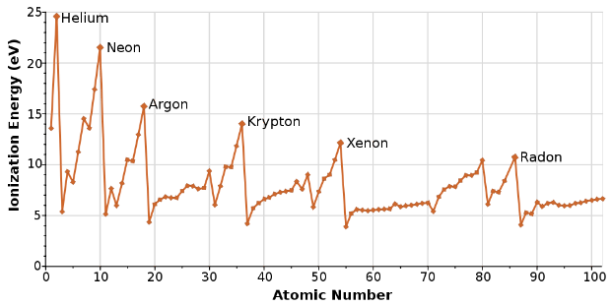
Different graph of First Ionization Energy Trend

Slide 44
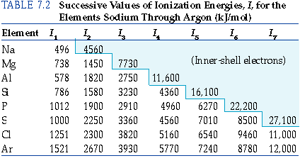
7.4 Ionization energy table

Slide 45
Rank the following in terms of increasing first ionization energy (I1)
H, K, Na
Cl, F, Br, I
Ne, Na, P, Ar, K
Which has the lowest first ionization energy, which has the lowest?
B, Al, C, Si?

Slide 46
Rank the following I1, I2, I3 of increasing value
Remember
I1 - first ionization energy
I2 - second ionization energy
I3 - third ionization energy
Mg -
Na -

Slide 47
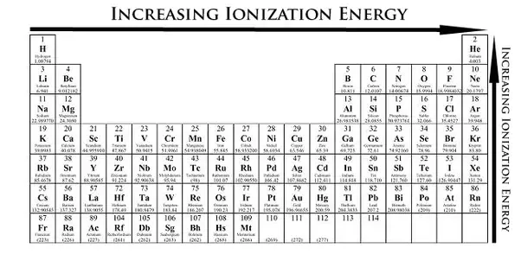
7.4 Ionization Energy Trend

Slide 48
7.4 Electron Configurations of Ions
During the formation of ions, electrons are always removed from the highest principle quantum number first
i.e. electrons will be removed from 4s orbitals before they are removed from 3d
We have already been practicing this

Slide 49
7.4 Electron Configurations of Ions
Write the electron configurations for…
Li +
Fe 2+
Co 3+
S 2-

Slide 50
7.5 Electron Affinity
While ionization energy measures the amount of energy needed to free an electron…
Electron affinity measures the amount of energy needed to attach an electron
Cl (g) + e- —> Cl- (g) E = -349 kJ/mol
For most atoms, energy is released when electrons are added (exothermic)

Slide 51
7.5 Ionization vs Affinity
To put it simply…
Ionization measures the ease at which atoms lose electrons
Affinity measures the ease at which an atom gains an electron
The lower the value for affinity (more exothermic), the easier it is for an atom to gain an electron
More negative values for affinity corresponds to the atoms attraction to electrons

Slide 52
7.5 Trend in affinity
We will look at the summary slide at the end of this section but..
Electron affinity generally increases left to right across a row
Changes only slightly down a group, but affinity does decrease due to atomic size
Larger atom, less electron - nucleus attraction

Slide 53
7.5 Exceptions
While affinity increases left to right, we can predict that the attraction will essentially stop at the noble gases
Will their energy values for affinity be really high or low?
Group 5a (N, P, As) are anomalies in the pattern
Group 2a gain electrons is also unfavorable because they would now need to promote an electron to an empty p orbital

Slide 54
7.5 Exceptions

Slide 55
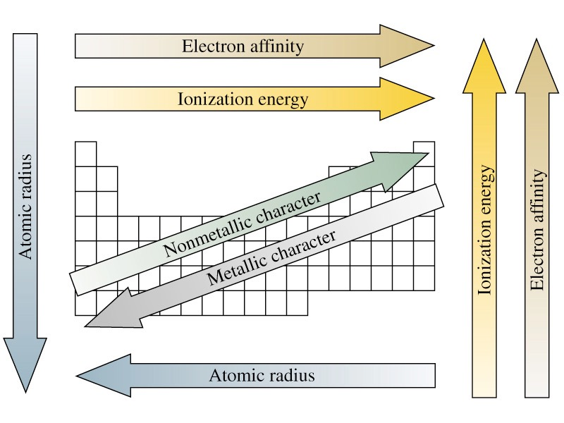
Trend Summary

Slide 56
7.6 Metals, Nonmetals, and Metalloids
Approximately 75% of the elements on the table are metals (left of the staircase)
Exception: Hydrogen (nonmetal)
Aside from the noble gases, no elements exist alone as individual atoms
To really investigate trends, we must look at the properties that involve collections of atoms

Slide 57
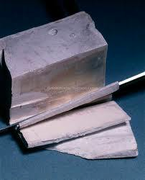
7.6 Metals
Metallic character - the more an element exhibits properties of metals
Metal properties
Luster (shiny!)
Conduct heat and electricity
Malleable
High melting points
Low ionization energies - form + ions
Pure sodium metal

Slide 58
7.6 Metals

Slide 59
7.6 Nonmetals
Non-metallic character

